Slide 1
Development of a Coefficient of Conservatism Database for Southeast Wetland Plants
for Use in Floristic Quality Assessment
Kristie Gianopulos, M.S.
North Carolina Dept. of Environment and Natural Resources
Wetland and Stormwater Branch
Program Development Unit
Funded by a Southeast Region IV EPA
Wetland Program Development Grant
Presentation to the 2013 Mid-Atlantic Wetland Workgroup meeting Gettysburg, PA
Notes:
This work was made possible by a EPA Wetland Program Development Grant.

Slide 2
Contributing Botanists
Quinton “Guy” Anglin, Florida Dept. of Environmental Protection, FL
Julian Campbell, Bluegrass Woodland Restoration Center, KY
Lee Echols, North American Land Trust, GA
Dwayne Estes, Austin Peay State University, TN
Derick Poindexter, University of North Carolina – Chapel Hill, NC
Milo Pyne, NatureServe, NC
Michael Schafale, North Carolina Natural Heritage Program, NC
Al Schotz, Alabama Natural Heritage Program, AL
Ed Schwartzman, North Carolina Natural Heritage Program, NC
Bruce Sorrie, North Carolina Natural Heritage Program, NC
Dan Spaulding, Anniston Museum of Natural History, AL
Bob Upcavage, University of South Florida & Environmental Consultants, FL
Alan Weakley, University of North Carolina – Chapel Hill, NC
Deb White, Kentucky State Nature Preserves Commission, KY
Wendy Zomlefer, University of Georgia, GA
November 2013

Slide 3
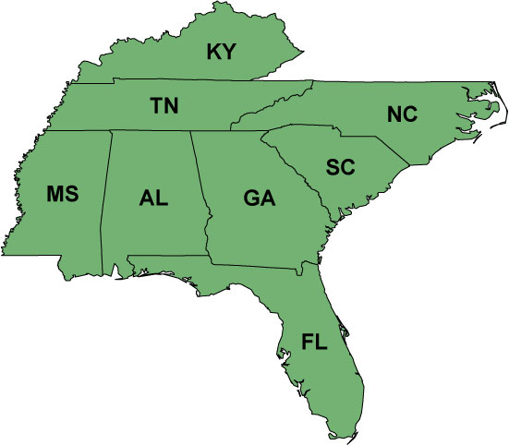
EPA Region IV states
November 2013

Slide 4
Current C Values in the Southeast
(upland & wetland species)
Alabama - ?
Florida – South Florida (~1340 spp), FL marshes (~400 spp)
Georgia – unpublished list
Kentucky – web-published list (~1900 spp)
Mississippi – northern MS only (~400 spp)
North Carolina – limited, unpublished (~700 spp)
South Carolina - ?
Tennessee – unpublished list (~2300 spp)
November 2013

Slide 5
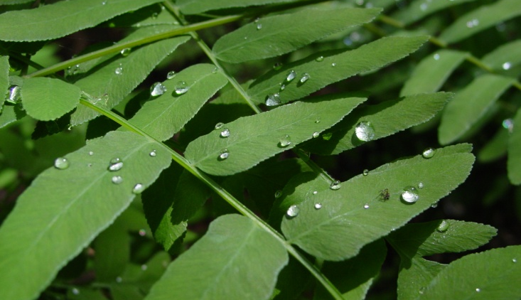
SE Wetland Plants C Value Database Objective
A central database of C values for wetland plants occurring in the Southeast for use by scientists, agencies, wetland managers, mitigation bankers, permit applicants, etc.
NWCA data analysis
November 2013

Slide 6
SE Wetland Plant C Value Database Development Method Overview
Compiled wetland plant database – Sep 2012 -Mar 2013
Surveyed experienced botanists for best practices/ideas
Selected/contracted expert botanists – Dec 2012 to Apr 2013
Pre-scoring – Mar to June 2013
Panel meeting of botanists – June 2013
Post-meeting – July to Sept 2013
Follow-up on unassigned or tabled species
Assembly of C values into main database with assigned C value by ecoregion
Target end date: Sept. 30, 2013
November 2013
Notes:
Surveyed botanists who had participated in the development of C Value database for their area or state

Slide 7
SE Wetland Plant C Value Database Development
“Defining” a wetland plant
FAC or wetter (FAC, FACW, OBL) in at least one region on the NWPL
Eastern Mtn/Piedmont
Atlantic/Gulf Coastal Plain
Tagged in database as “Non-Upland”
Map Source: US Army Corps
November 2013

Slide 8
SE Wetland Plant C Value Database Development
Compiling the wetland plant database
USDA PLANTS database download
Added extra information: 2012 (2013) NWPL info, ecoregion occurrence (based on county record info)
Other available state C values from within/adjacent to SE region states
Assignment by ecoregions, rather than by state
November 2013
Notes:
Downloaded info for all species, all states in Region IV, sci name, common name, dicot/monocot, growth, duration, nativity, protected sp status, county records

Slide 9
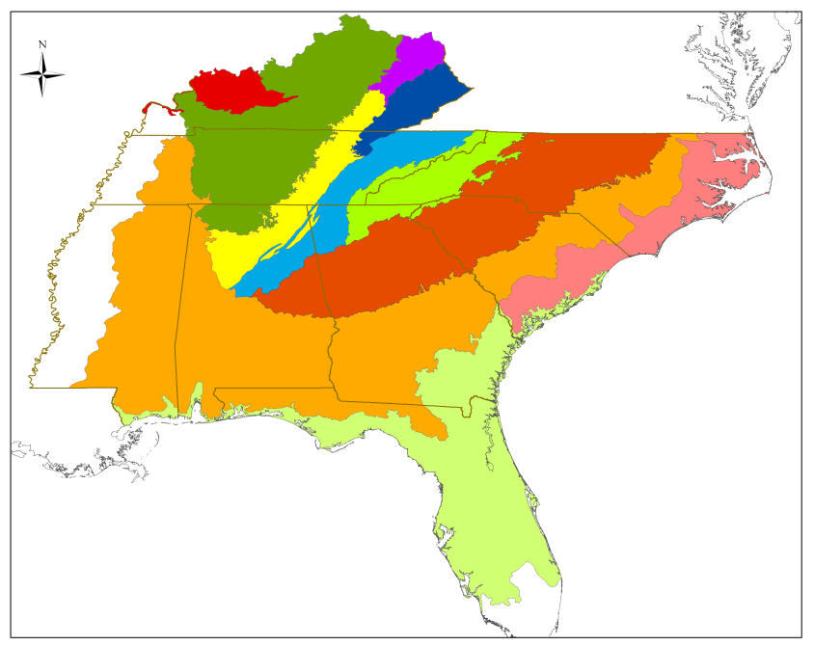
SE Wetland Plant C Value Database Development
Compiling the wetland plant database
476 Counties included (South FL, western MS excluded)
2,428 unique taxa (FAC or wetter on NWPL)
November 2013
Notes:
If we considered each species in each ecoregion where it occurs, the result would be 11,000 C values to be assigned.

Slide 10
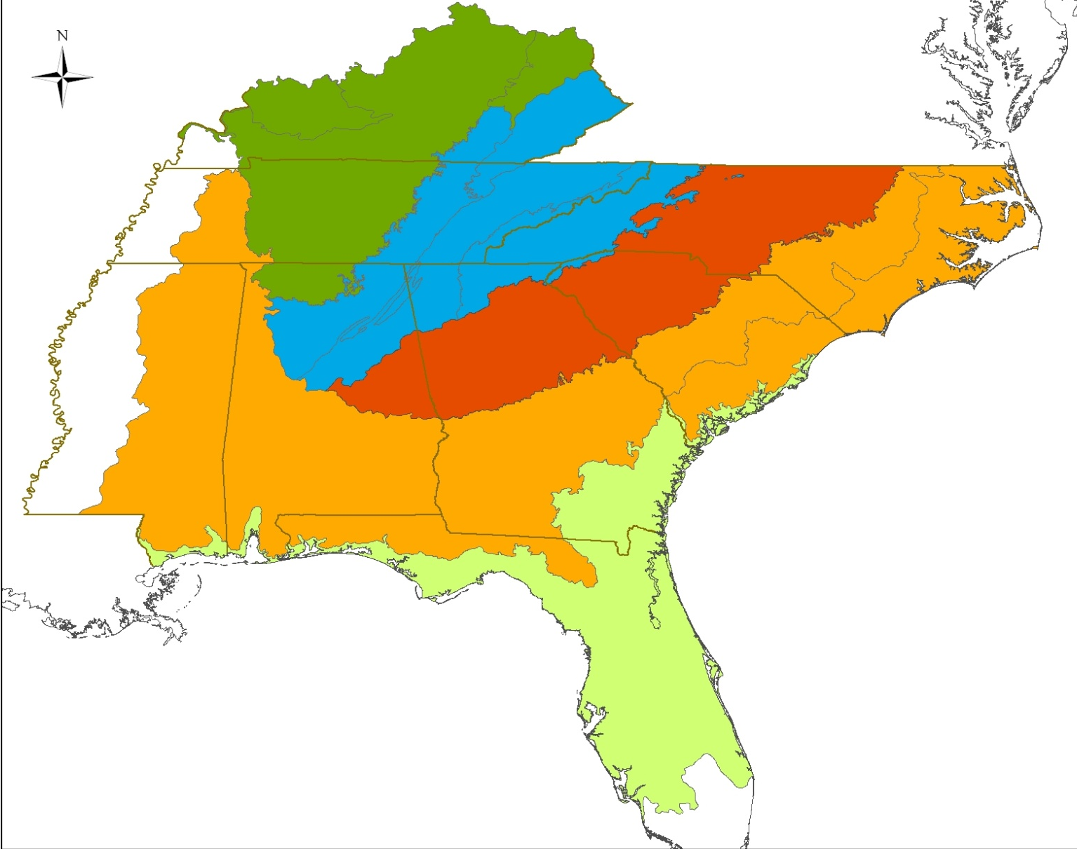
Interior Low Plateau (ILP)
~11,000 C values
Mountains (Mtn)
Piedmont (Pdmnt)
Coastal Plain (CP)
~7,000 C values
Southern Coastal Plain (SCP)
November 2013
Notes:
We decided, based on input from various botanists here in in the EPA, to group some of these ecoregions into these 5: Interior Low Plateau….. This grouping reduced the number of C values from 11,000 down to a more manageable 7,000.

Slide 11
SE Wetland Plant C Value Database Development
Botanist Selection
Field experience emphasized; 15 years minimum
All states were covered by 2-6 botanists, some areas up to 10
15 botanists contributed
Kickoff Webinar Mar 2013
Pre-scoring (12 botanists)
Meeting June 2013
November 2013
Notes:
So alongside compiling the wetland plant database, I also was searching for botanists to participate in assigning the C values. I contacted around 60 botanists, got responses from about 25 of them, and contracted or selected 15 of those. We were looking especially for field-oriented botanists, based on advice which I obtained through surveys from other botanists who had experience with CofC projects in other regions or states.

Slide 12
Coefficient of Conservatism Criteria
The Coefficient of Conservatism concept will be thought of primarily in the context of a species’ ability to tolerate anthropogenic alteration. This is a concept distinct from generalized disturbance, specifically natural disturbance, such as fire or flooding. A plant species which requires a high frequency of natural disturbance may receive a high C value, if it shows a low tolerance of anthropogenically-driven alteration. While there is a loose correlation between rarity and high C value, rarity alone is not an indicator of a species tolerance to alteration, and will therefore not be relied upon in the development of C scores.
0: Non-native species.
1: Taxa adapted to severe anthropogenic habitat alteration, occurring so frequently that often only brief periods are available for growth and reproduction of the species. These species are also able to colonize areas with high degrees of anthropogenic alteration. Many also do well with severe natural disturbance, but most occurrences are in heavily altered areas. (Zero confidence that a specimen brought into an herbarium was collected from a remnant or high-quality natural area.)
2-3: Taxa associated with somewhat more stable, though degraded, environments.
4-6: Taxa that persist with moderate alteration, but which decline with more intense, long-lasting, or frequent anthropogenic alteration. Many are also present in natural areas, and may be dominant or matrix species with broad habitat tolerance. (A specimen brought into an herbarium may be from either a high- quality natural area or from a moderately altered site).
7-8: Taxa associated mostly with well-established natural areas, but that can be found persisting where the habitat has been degraded somewhat.
9-10: Considered to be restricted to high-quality natural areas, including those which show high frequencies of natural disturbance such as flooding or fire. These species often exhibit a high degree of fidelity to a narrow range of habitat requirements, but may be tolerant of a broader range of high-quality natural habitats. (Nearly 100% confidence that a sample brought into an herbarium was collected from a remnant or high-quality natural area.)
November 2013

Slide 13
Pre-Scoring Database
November 2013

Slide 14
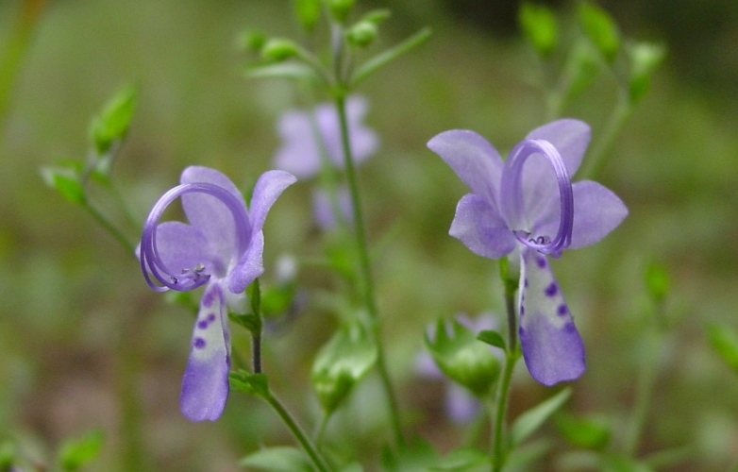
Pre-Scoring was Essential!
Scores in agreement and ave. score was accepted if:
Range of scores < 2 if 3+ botanists assigned
Range of scores < 3 if 4+ botanists assigned
400 species rec’d agreeing scores (all ecoregions)
+ indiv. ecoregional scores =
2,086 accepted final scores (29%)
November 2013
Notes:
Range = highest minus lowest

Slide 15
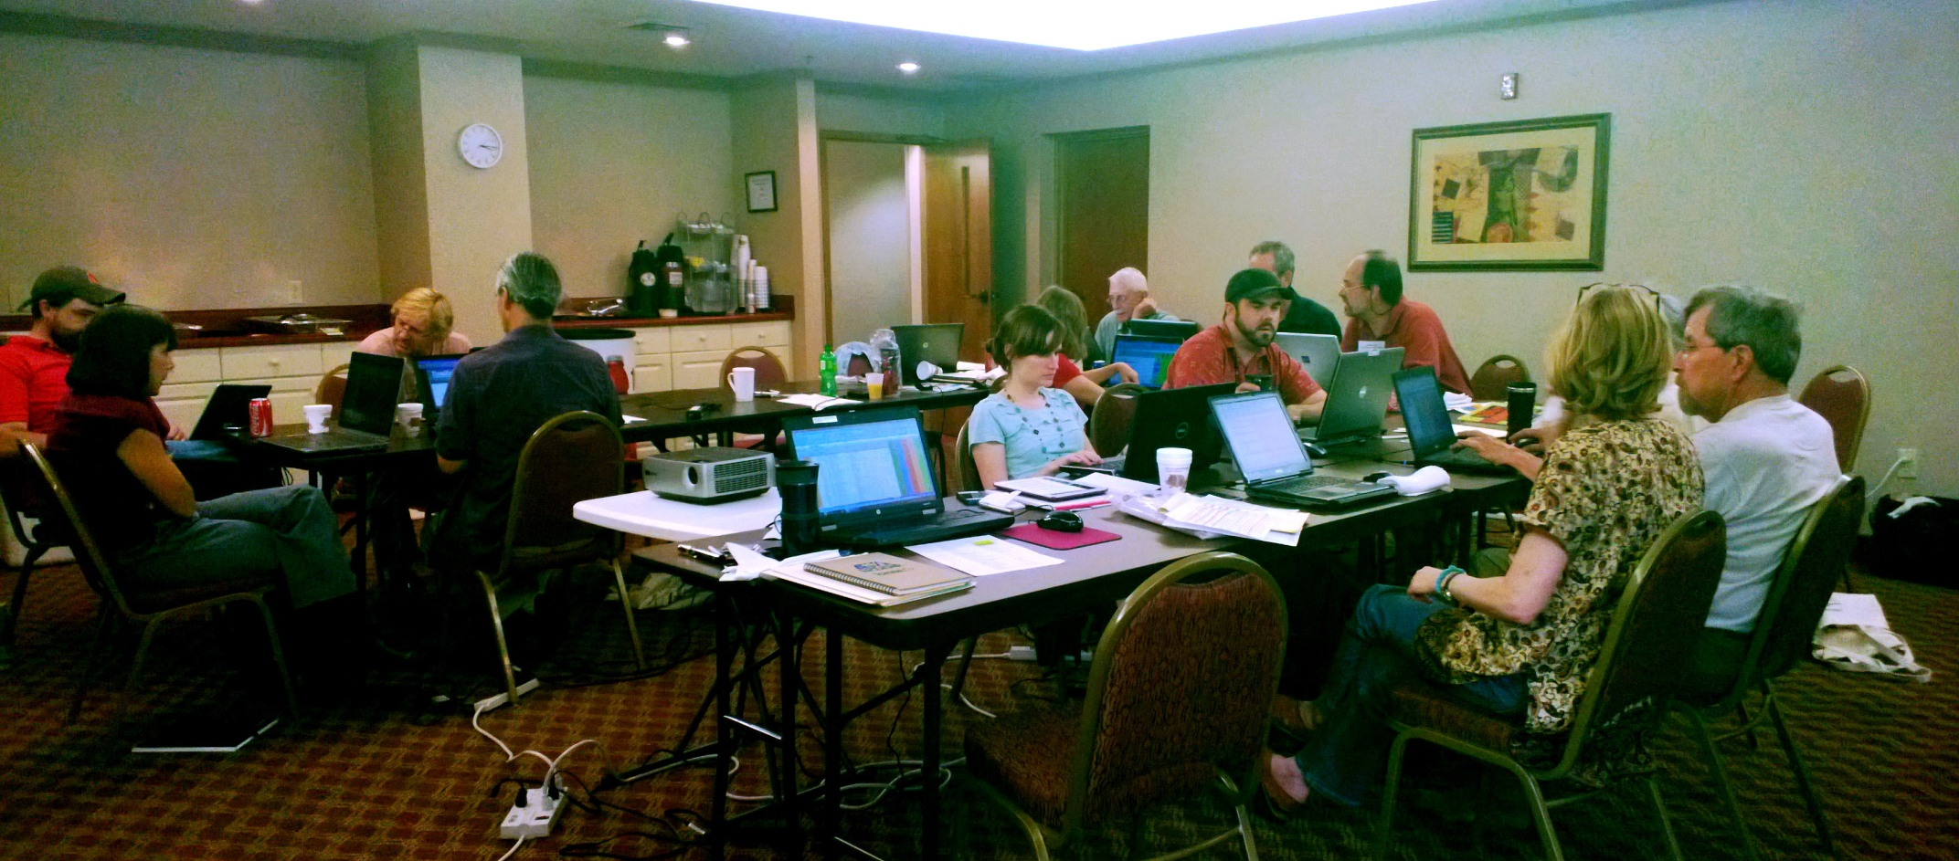
Mountains/Interior Low Plateau (ILP) Group
Southern Coastal Plain Group
Coastal Plain/ Piedmont Group
363 years total combined botanical experience
4 full days x 11 botanists and 3 helpers x 165 words/minute =
3,168,000 spoken words
November 2013

Slide 16
Pre-scored
After 4-Day Meeting
All Tabled 3.3%
Complete: 96.7%
Tabled: 3.3%
Unfinished: 0%
Complete: 29%
Unfinished: 71%
November 2013

Slide 17
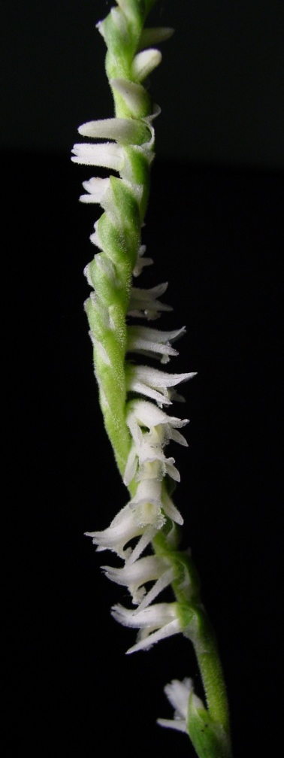
Post Meeting
Tabled Species
Email followup – 219 values needing further research; this was reduced to 120 permanently tabled
QA/QC
Publication of Database to SEWWG website – Sept. 2013
Final Report – Feb. 2014
November 2013

Slide 18
What Does the Database Look Like?
2,416 species scored (FAC or wetter on NWPL, or added by botanists)
6,945 C values across all ecoregions
1.7% (120 C values) were permanently tabled as undetermined (UND) in database
133 species excluded from original USDA download – not wetland species, out of range, redundant nomenclature, epiphytes, etc.
Interior Low Plateau (ILP)
Mountains (Mtn)
Piedmont (Pdmnt)
Coastal Plain (CP)
Southern Coastal Plain (SCP)
November 2013
Notes:
24 species could not be determined, plus certain ecoregions (pdmnt primarily) for other species

Slide 19
November 2013

Slide 20
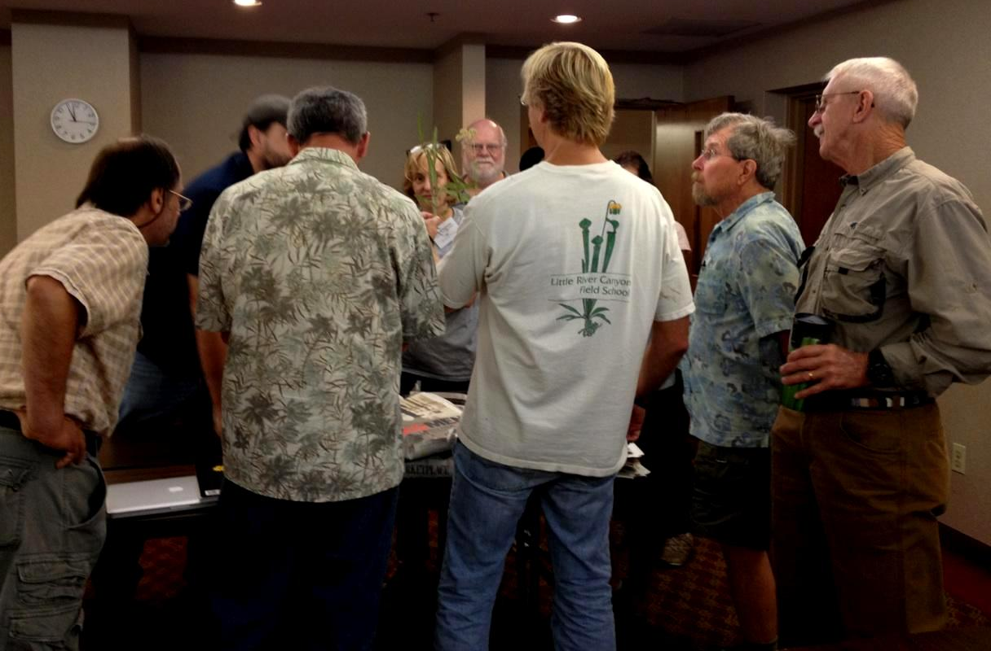
November 2013
Notes:
What we did in cases where range in scores assigned was 4 or more, scored by consensus, rather than average.

Slide 21
Distribution of Average C Values: Wetland Plants in the Southeast
Listed = Federal or State Listed Species in Any Part of the Ecoregion
November 2013
Notes:
Explain wide variation of C value between ecoregions.

Slide 22
Average C Value Distributions
SEWWG (WETLAND FLORA)
Mean C = 5.6
MAWWG (WETLAND FLORA)
NEBAWWG (TOTAL FLORA)
Mean C = 6.3
Mean C = 3.9
November 2013
Notes:
MAWWG did assign zeros to native invasive flora, so this graph doesn’t include non-natives

Slide 23
Annual vs. Biennial/Perennial
Mean C = 3.8
Mean C = 6.2
November 2013
Notes:
Non-natives comprise a larger proportion of the total annual species than do the non-native biennial/perennial species.
Of course the above graph is a little misleading given the much smaller overall number of annuals compared to longer duration plants, so here’s a side-by-side comparison with the same scale.

Slide 24
C Value Distributions by Ecoregion
Listed = Federal or State Listed Species in Any Part of the Ecoregion
Southern Coastal Plain
Ave C = 5.1
Coastal Plain
Ave C = 5.5
Piedmont
Ave C = 5.0
Mountains
Ave C = 5.7
Interior Plateau
Ave C = 5.5
November 2013
Notes:
Define listed
WETLAND species only

Slide 25
USING THE DATABASE
NWCA
North Carolina –
Intensification Grant – NC, AL, SC, GA
Florida –
WPDG to develop index of wetland integrity
Revisions to UMAM
Mitigation policy
Tennessee Valley Authority – 7 state region
NEPA review field work
NEXT STEPS
Publication in literature
FQAI Calculator?
November 2013

Slide 26
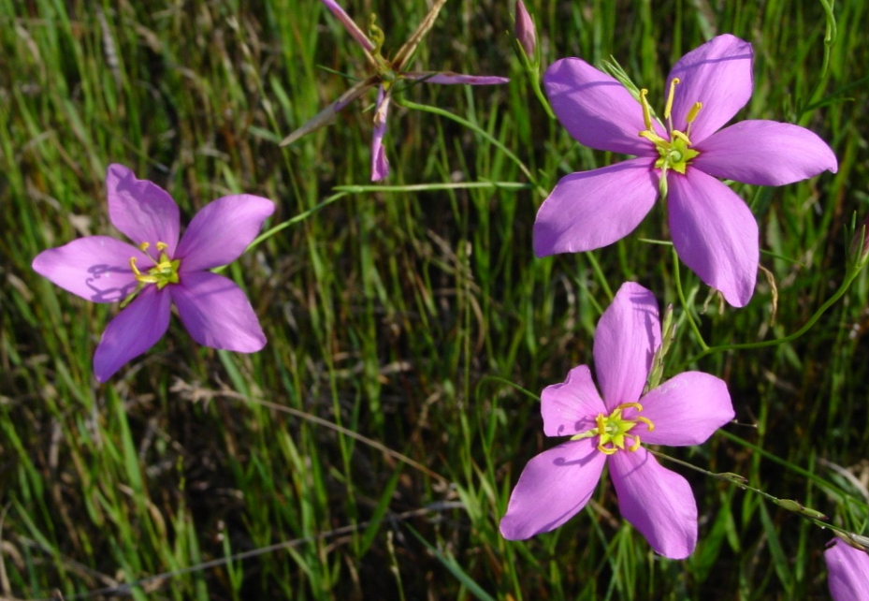
Acknowledgements
Panel Botanists: Quinton “Guy” Anglin, Julian Campbell, Lee Echols, Dwayne Estes, Derick Poindexter, Milo Pyne, Michael Schafale, Al Schotz, Ed Schwartzman, Bruce Sorrie, Dan Spaulding, Bob Upcavage, Alan Weakley, Deb White, Wendy Zomlefer
Assistants:
Virginia Baker (DENR)
Rick Savage (DENR)
James Graham (DENR)
Lori Montgomery (DENR)
Kim Matthews (RTI Inc.)
Webinar & Database Posted:
www.ncwetlands.org
http://sewwg.rti.org
Kristie.Gianopulos@NCDENR.gov
919-743-8479
November 2013

